Slide 1
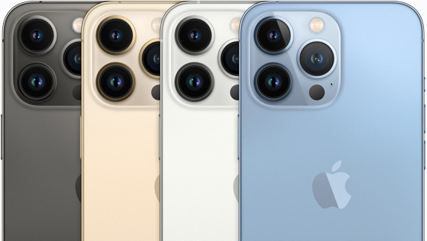
Iphone 13
Made by Sapiya Kanagat

Slide 2

Iphone 13 pro: 6’7 Iphone 13: 6’1
New screen, bigger, better and lighter

Slide 3

camera system: Telephoto, Wide, and Ultra Wide cameras Telephoto: ƒ/2.8 aperture Wide: ƒ/1.5 aperture Ultra Wide: ƒ/1.8 aperture and 120° field of view 100% Focus Pixels (Wide) 4K video recording at 24 fps, 25 fps, 30 fps, or 60 fps Cinematic video stabilization (4K, 1080p, and 720p)
New cameras, clearer and bigger.

Slide 4

All-new 5‑core GPUdelivers up to 50% faster graphics performance than any other smartphone chip A15 Bionic is the world’s fastest smartphone chip.
New processor A15

Slide 5
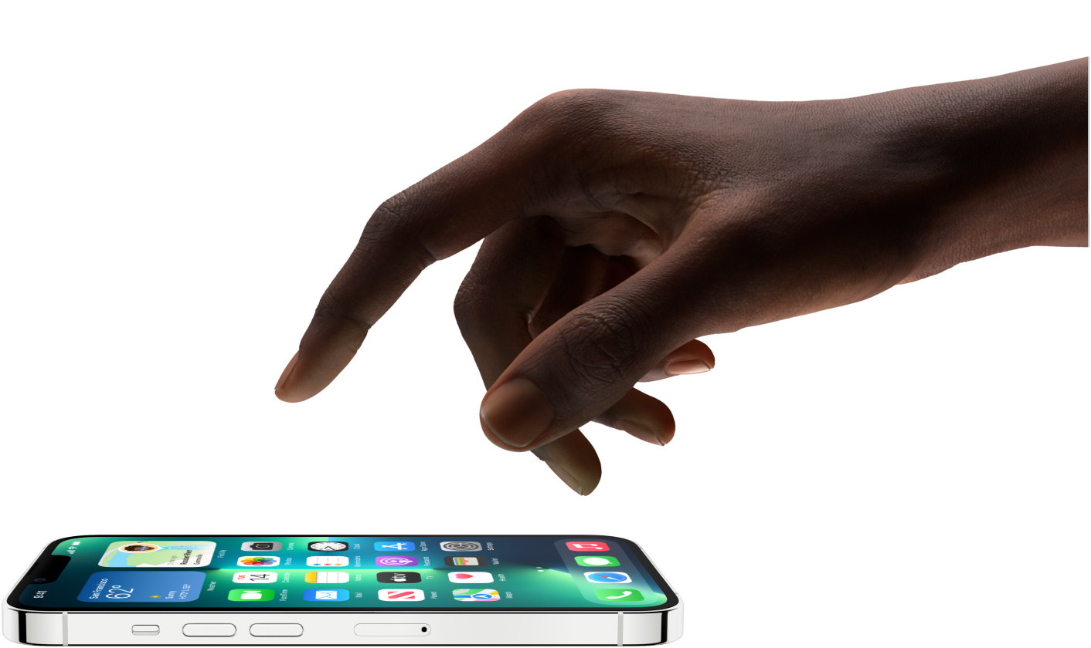
Hello, ProMotion. NEW 120 HZ screen absolute density
Other features:

Slide 6
In this slide I used some powerpoint features as inserting text and pictures of format jped, heic and png, also in first slide I made my own design of page. For theme I used recent apple presentation of new iphone model. I really like this mobile phone and his innovations. All information was taken from official page: apple.com

